Slide 1
Python Network Programming
Socket programming
TCP Socket programming
Web Service: HTTP Protocol

Slide 2
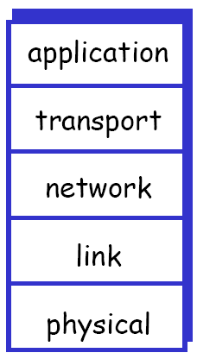
Internet TCP/IP Protocols
Internet Protocol stack
HTTP, SMTP, FTP, TELNET
TCP, UDP
IP
Ethernet, WiFi, LTE, …

Slide 3
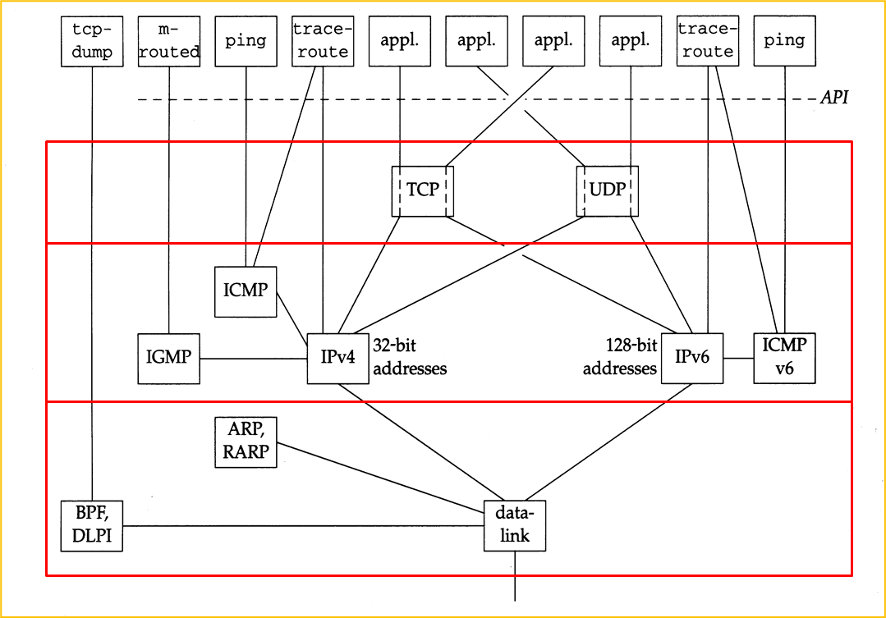
TCP/IP Protocols

Slide 4
TCP and UDP Sockets
TCP
connection oriented service: point-to-point connection
data exchange after making a connection
연결설정 - 데이터전송 - 연결해제
TCP socket:
연결 두 종단점 정보를 가짐
(local_endpoint, remote_endpoint)
연결 종단점: (IP주소, 포트번호)
포트번호: 16비트 정수

Slide 5
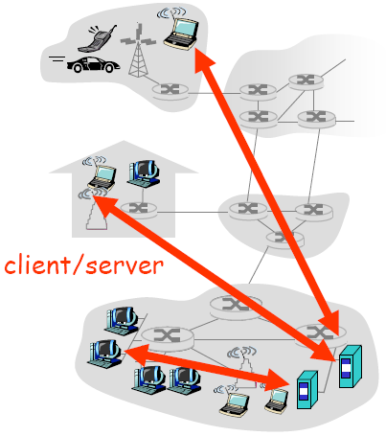
Client-server Message Exchange
server:
Provide a service to clients; always-on host
서비스 준비를 하고 클라이언트로부터 연결요청을 기다림
client:
Receive a service from a server
필요할 때 서버에 연결요청을 보내고, 연결이 되면 서비스 요청 메시지 전송

Slide 6
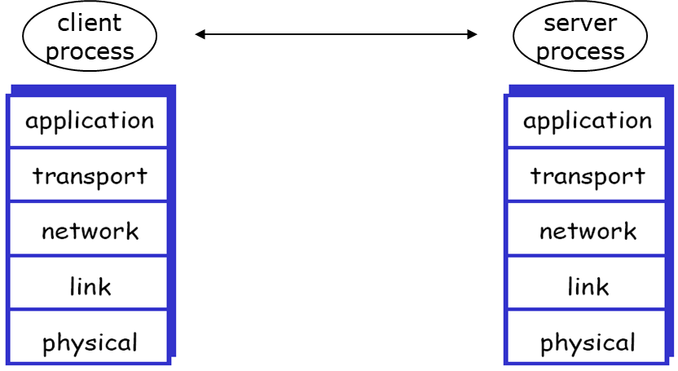
TCP and UDP Sockets
Message exchange in Internet
www
browser
www
server
HTTP
HTTP
TCP
TCP
IP
IP
socket

Slide 7
TCP Socket Programming
TCP Client-server interaction
Server
Client

Slide 8
Python Socket Programming
Socket module: socket
contains a low-level API for BSD socket
server socket methods:
socket.socket() – create a socket
socket.bind() – bind a local end-point of a socket
socket.listen() – change the socket to LISTEN state
socket.accept() – accept a connection request from a client
socket.send() – send data through the connected socket
socket.recv() – receive data from the connected socket

Slide 9
Socket Programming
Socket module: socket
client socket methods
socket.socket() – create a socket
socket.connect() – connect to a server socket
socket.send() – send data through the connected socket
socket.recv() – receive data from the connected socket

Slide 10
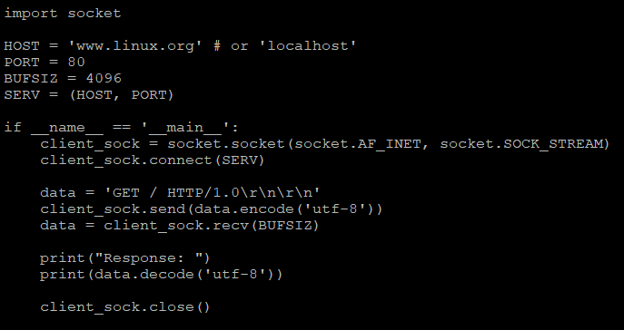
Socket Programming
Client example : web request

Slide 11
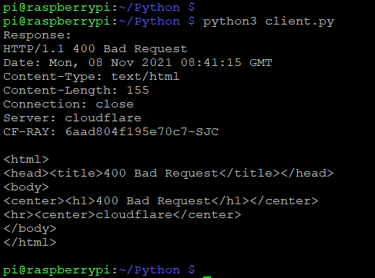
Socket Programming
Client example : web request

Slide 12
Socket Programming
Daytime 서비스
Client
time
Server
현재 시간값
time
현재 시간값
quit

Slide 13
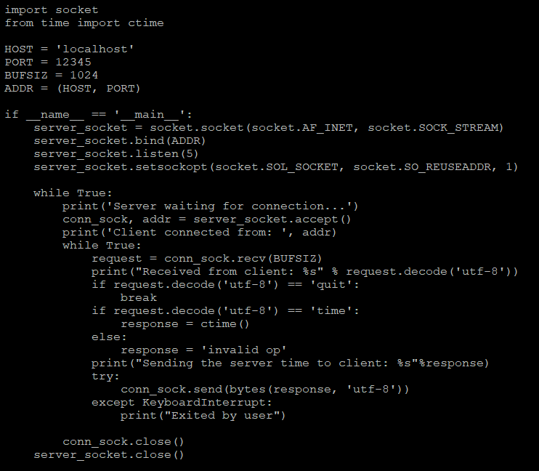
Socket Programming
Server – time server (1)

Slide 14
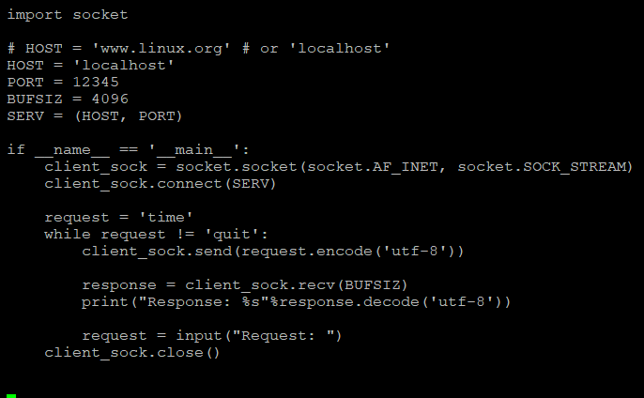
Socket Programming
Server – time server (2)

Slide 15
Socket Programming
Client – time client

Slide 16
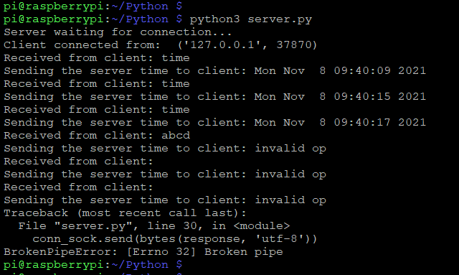
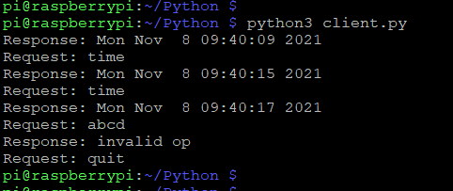
Socket Programming
Server-client: run

Slide 17
Python Programming Exercise
Echo 서비스
Client
student
Server
STUDENT
Client
I am a student
Server
I AM A STUDENT
위와 같이 동작하는 클라이언트와 서버 프로그램을 작성

Slide 18
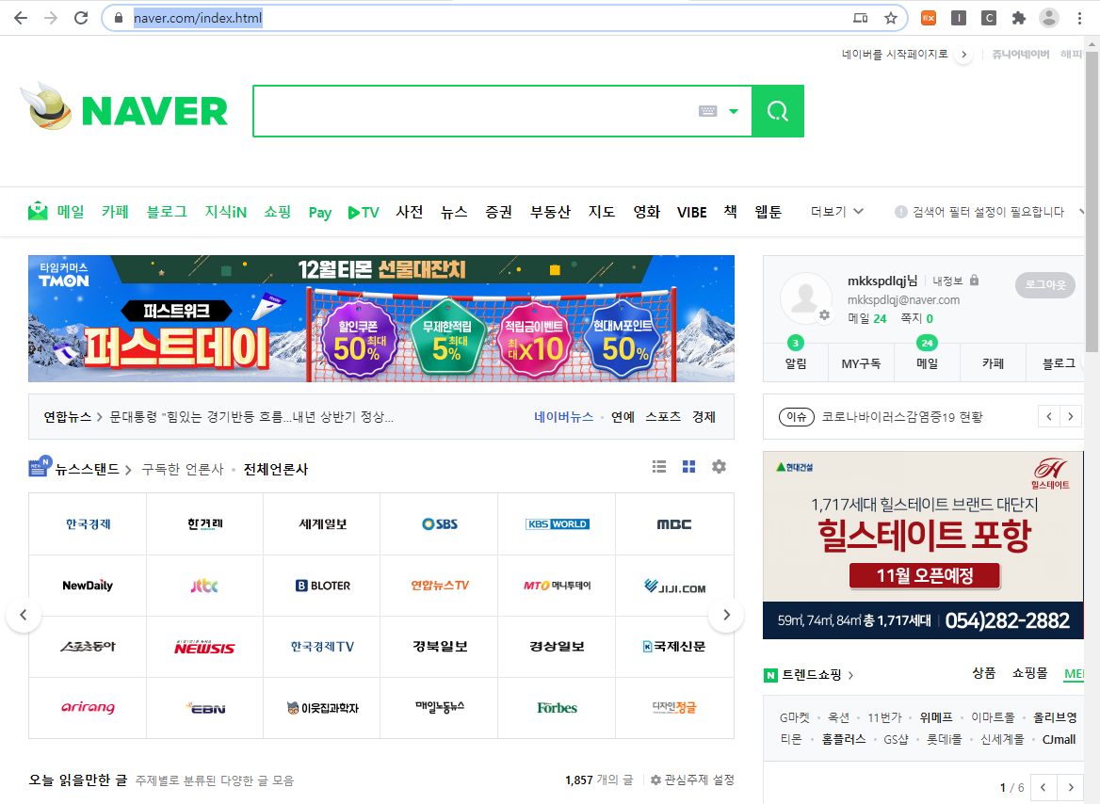
Web

Slide 19
Web
Web page consists of objects
Object can be HTML file, JPEG image, Java applet, audio file, …
Web page consists of base HTML-file which includes several referenced objects
Each object is addressable by a URL
Example URL:
http://www.naver.com/index.html

Slide 20
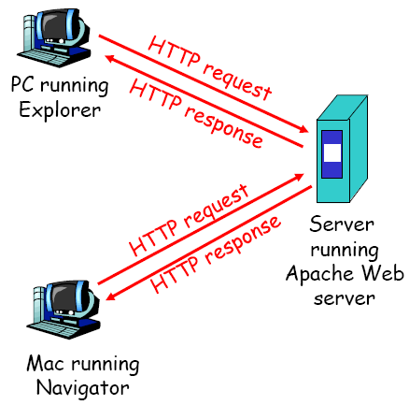
Web
HTTP: hypertext transfer protocol
Web’s application layer protocol
client/server model
client: browser that requests, receives, “displays” Web objects
server: Web server sends objects in response to requests

Slide 21
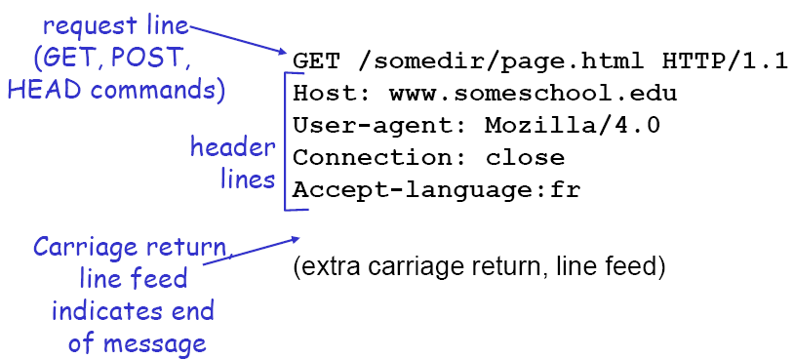
HTTP Message
two types of HTTP messages: request, response
HTTP request message:
ASCII (human-readable format)
index.html
Host: www.naver.com
Accept: text/html
Header
Payload

Slide 22
HTTP Message
HTTP/1.0
GET
POST
HTTP/1.1
GET, POST
PUT
uploads file in entity body to path specified in URL field
DELETE
deletes file specified in the URL field

Slide 23
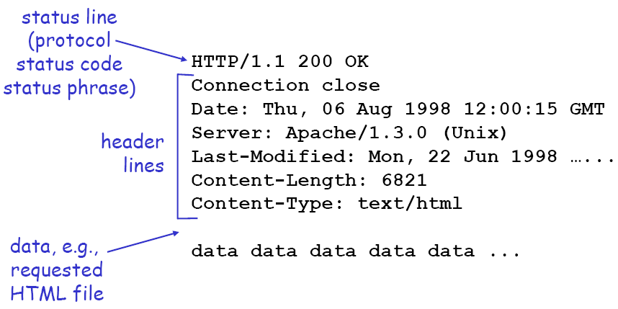
HTTP Message
<HTML message … >

Slide 24
HTTP Message
Status code
200 OK
request succeeded, requested object later in this message
301 Moved Permanently
requested object moved, new location specified later in this message (Location:)
400 Bad Request
request message not understood by server
404 Not Found
requested document not found on this server

Slide 25
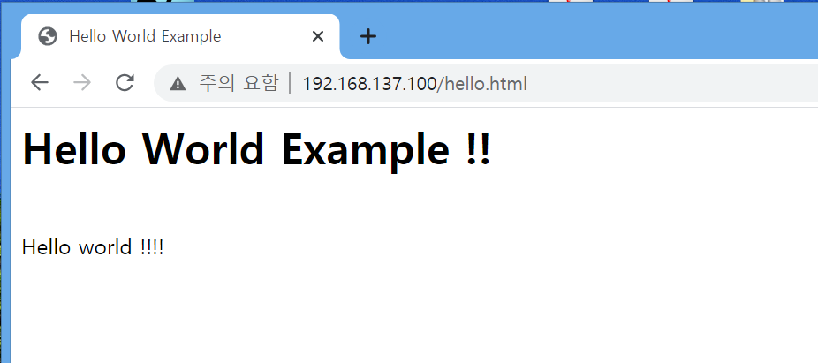
HTML Message
HTML message
enclosed in <html> and </html>
consists of HEAD and BODY
<html>
<head>
<title>Hello World Example</title>
</head>
<body>
<H1>Hello world Example !!</H1></br>
Hello world !!!!
</body>
</html>

Slide 26
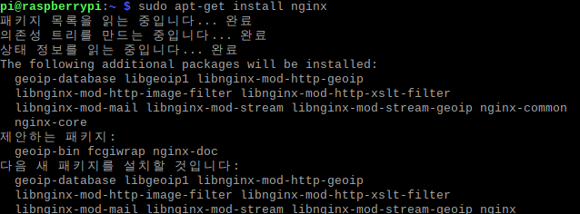

HTML Message
HTML install
Sudo apt-get install nginx
Service nginx start

Slide 27


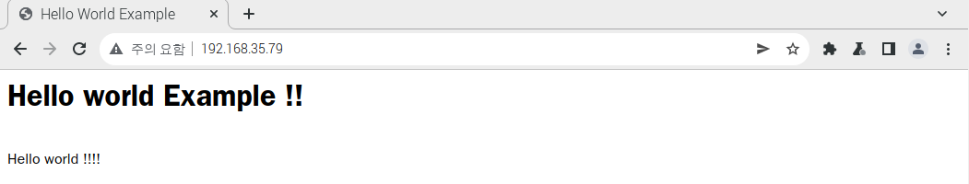
HTML Message
HTML setting

